Slide 1
Advanced Queries
Set operations, Builtin functions and Joins!

Slide 2
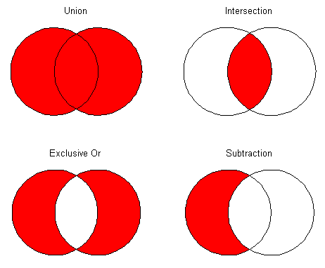
Set operations
UNION, INTERSECT & EXCEPT

Slide 3
UNION
SELECT column FROM table1
UNION
SELECT column FROM table2;

Slide 4
UNION ALL
SELECT column FROM table1
UNION ALL
SELECT column FROM table2;

Slide 5
INTERSECT
SELECT column FROM table1
INTERSECT
SELECT column FROM table2;

Slide 6
EXCEPT
SELECT column FROM table1
EXCEPT
SELECT column FROM table2;

Slide 7
Built-in Functions
For Strings and Numbers

Slide 8
String Functions
SELECT UPPER(column), LOWER(column), LENGTH(column), SUBSTRING(column, start, length)
FROM table;

Slide 9
Numeric Functions
SELECT ABS(column), CEIL(column), FLOOR(column), ROUND(column, decimals)
FROM table;

Slide 10
Subquery in WHERE
SELECT column FROM table
WHERE column IN
(SELECT column FROM table2 WHERE condition);

Slide 11
Subquery in FROM
SELECT alias.column
FROM (SELECT column FROM table WHERE condition) AS alias;

Slide 12
Subquery in SELECT
SELECT
column1,
(SELECT column FROM table2 WHERE condition) AS alias
FROM table1;

Slide 13
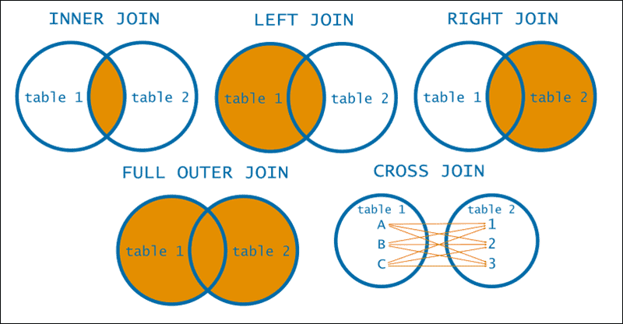
Joins

Slide 14
INNER JOIN
SELECT columns
FROM table1 INNER JOIN table2 ON table1.column = table2.column;

Slide 15
LEFT JOIN
SELECT columns
FROM table1 LEFT JOIN table2
ON table1.column = table2.column;

Slide 16
RIGHT JOIN
SELECT columns
FROM table1 RIGHT JOIN table2
ON table1.column = table2.column;

Slide 17
CROSS JOIN
SELECT columns
FROM table1 CROSS JOIN table2;

Slide 18
SELF JOIN
SELECT a.columns, b.columns
FROM table as a, table as b
WHERE a.common_column = b.common_column;

Slide 19
Data Manipulation
INSERT, UPDATE & DELETE

Slide 20
INSERT
INSERT INTO table (column1, column2)
VALUES (value1, value2);

Slide 21
UPDATE
UPDATE table
SET column1 = value1, column2 = value2
WHERE condition;

Slide 22
DELETE
DELETE FROM table
WHERE condition;

